Slide 1

Github 01100101
Chris Murray - @chris18890

Slide 2

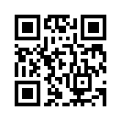
Who am I?
Chris Murray
Infra consultant at HCC (relocated from Belfast Jan 2017)
Makerspace Member
@chris18890 – Twitter/GitHub/LinkedIn/<insert social network here>
“working knowledge” of PowerShell

Slide 3
What is a VCS?
VCS – version control system
Tracks changes to files
Allows rollback (revert)
Auditing of who did what (auditing/“blame”)
EG
CVS
SVN
TFS (Microsoft)

Slide 4
What is a DVCS
DVCS – Distributed Version Control System
No central store – every node has a complete copy of the repo & commit history
EG
Mercurial
Git
VSTS (Microsoft)

Slide 5

What is GitHub?
Implementation of Git as a SaaS model
SaaS – Software as a Service
Additional features besides pure Git
Public/Private repos
Issue tracking
Pull requests
Releases/tags
Projects
Wiki
GitHub Pages – static page serving
Graphs
Integration with CI/CD pipelines

Slide 6
Semantic Versioning
Given a version number MAJOR.MINOR.PATCH, increment the:
MAJOR version when you make incompatible API changes,
MINOR version when you add functionality in a backwards-compatible manner, and
PATCH version when you make backwards-compatible bug fixes.
Additional labels for pre-release and build metadata are available as extensions to the MAJOR.MINOR.PATCH format.
Taken from https://semver.org

Slide 7
GitHub Flow
https://guides.github.com/introduction/flow/
Anything in the master branch is deployable
To work on something new, create a descriptively named branch off of master (ie: new-oauth2-scopes)
Commit to that branch locally and regularly push your work to the same named branch on the server
When you need feedback or help, or you think the branch is ready for merging, open a pull request
After someone else has reviewed and signed off on the feature, you can merge it into master
Once it is merged and pushed to ‘master’, you can and should deploy immediately
Taken from http://scottchacon.com/2011/08/31/github-flow.html
More detail at https://nvie.com/posts/a-successful-git-branching-model

Slide 8

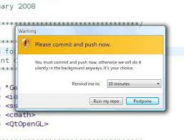
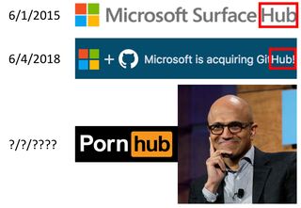
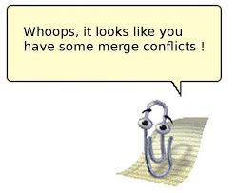
Elephant in the room
Microsoft bought GitHub

Slide 9
Demo – sign up for a GitHub account
https://github.com

Slide 10
Demo – set up GitHub on Windows

Slide 11
Demo – create repo with commits

Slide 12
Demo – pull repo on webhost & deploy

Slide 13
Demo – fork repo

Slide 14
Demo – commit to fork & PR

Slide 15
Wrap up
VCS – Version Control System
DVCS – Distributed Version Control System (EG Git)
Github – Implementation of Git in a SaaS model
Demos

Slide 16
Fin
Questions?

